Slide 1
Diabetes Data Set
By
Anusha

Slide 2
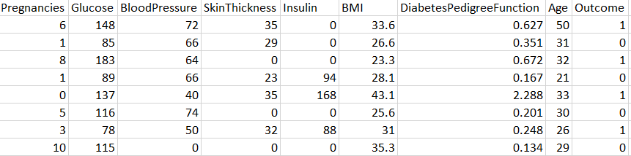
Dataset Name- Diabetes Prediction
Algorithm Used- Cluster(k-means),
Logistic Regression
Programming Tool- R
Overview of DataSet- There are 9 Variables and 768 Observations
Data is Related to Women of different ages and their diagnostic measures

Slide 3
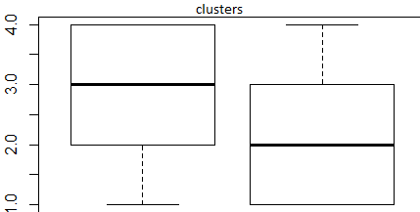
INSIGHTS FROM CLUSTER
Cluster1 - Age and BMI both is very less so the chance of diabetes is rare to occur
Cluster2 - Skin thickness and Insulin are very low in this cluster they may get diabetes
Cluster3 - There is more chances to occur the Diabetes
Cluster - They all are diabetes

Slide 4
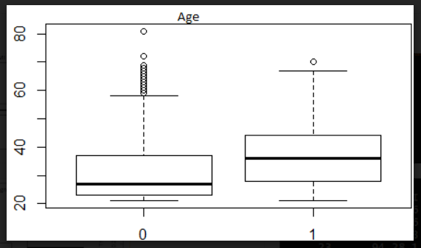
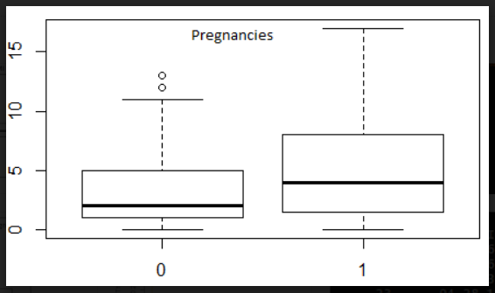
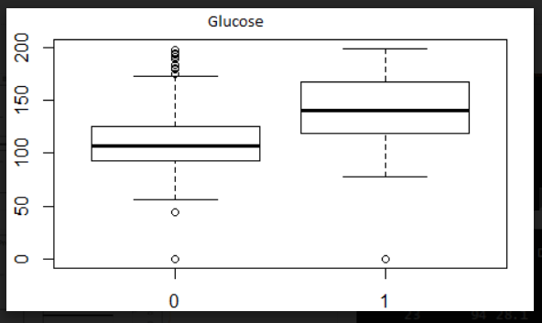
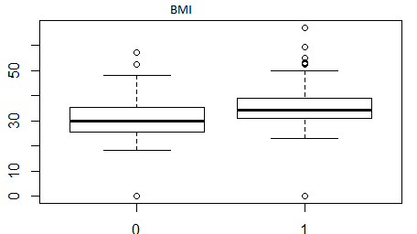

Slide 5
Split main data into Train and Test at 70:30 Ratio
Conducted Hypothesis Tests to identify the significant relationships.
Built a model with Logistic Regression Function (GLM)
Then Predicted the outcome in the Binary Form of 1 and 0.
In order to get the better accuracy, I have plotted ROC Curve .
With Reference to the ROC Curve I have tried multiple cut-offs for achieving better Accuracy.
Then I have validated my model with Test data and achieved similar AUC value and accuracy.

Slide 6
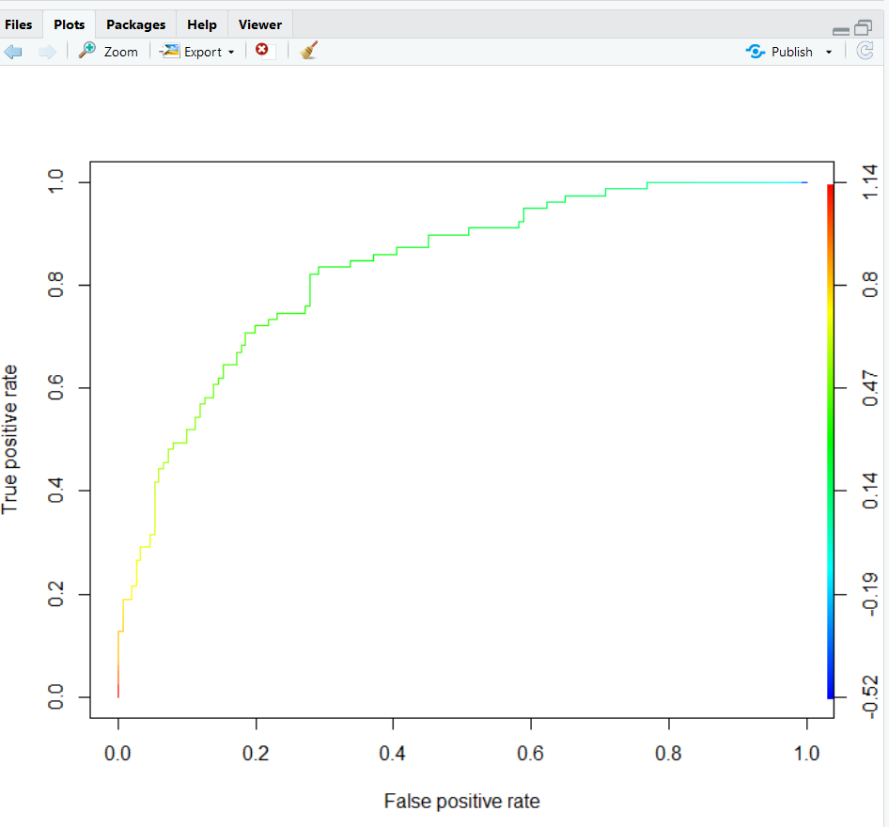
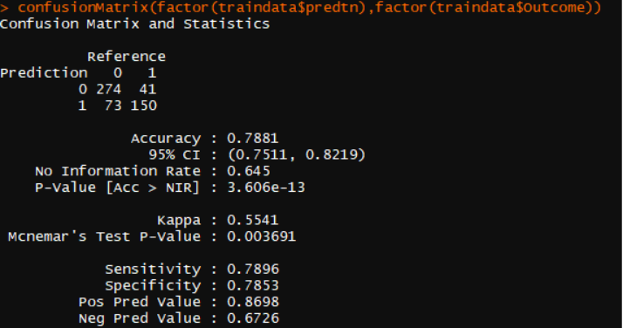
ROC Curve
Confusion Matrix
Area Under Curve - 0.84
Threshold Value - 0.37

Slide 7
INSIGHTS
As the No of Pregnancies increases there are high chances of occurring diabetes.
If the Person Age is more than 35 and Pedigree function is high then there are more chance for getting diabetes.
Glucose Tolerance Test is high with high insulin levels might cause diabetes.
Minimized the misclassification between Actually occurred and Predicted .

Slide 8
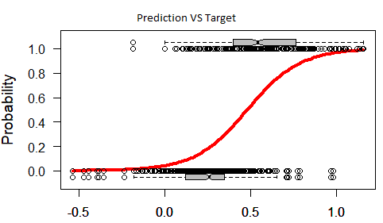
Thank You

